Slide 1
TELECOM CHURN PREDICTION

Slide 2
Index
Profile
Project Problem Statement
Project Pain Points
Approach adopted
Techniques and Tools
Analysis Section
Conclusion

Slide 3
Profile
Name : Farheen Syed
Qualification : Bachelors of Technology in Electrical and Electronics Engineering
Skills : Python, EDA, Statistics, Machine Learning, Power Bi, Ms. Excel
Experience : 3 years
Domain Experience : 2 years
Expertise in Budget allocation for each village/ Mandal (Based on the current per capita income of the village) ,Customer Relationship (Schemes and their Eligibility)

Slide 4
Project Problem Statement
In the telecom industry, customers are able to choose from multiple service providers and actively switch from one operator to another. In this highly competitive market, the telecommunications industry experiences an average of 15-25% annual churn rate. Given the fact that it costs 5-10 times more to acquire a new customer than to retain an existing one, customer retention has now become even more important than customer acquisition. Reduce customer churn, telecom companies need to predict which customers are at high risk of churn.

Slide 5
Project Pain Points
The Data is having Total 7043 observations with 33 variables . As I further moved towards the EDA I found few data challenge issues like the inadequate Data , Data Format issues. In Tenure Month Column there is abnormality is there (skewness) . After this I have done data transformation with help of functions or methods I found that there are null values in Total Charges and Churn Reason Column and there are no duplicate values in the data. After that I performed One of the Data Transformation Technique i.e., Deletion.

Slide 6
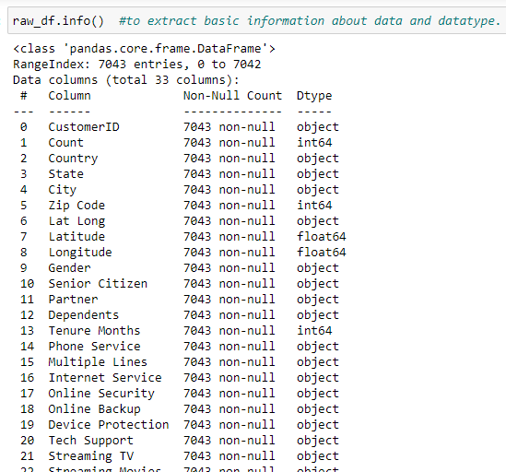
Exploratory Data Analysis and Data Cleaning
dataframe.info()
This method prints a concise summary of the data frame, including the column names and their data types, the number of non-null values, and the amount of memory used by the data frame.

Slide 7

As shown above, the data set contains 7043 observations and 33 columns.
Apparently, there are no null values on the data set; however, I observed that the column Total Charges was wrongly detected as an object .
For further analysis, I need to transform this column into a numeric data type. To do so, we can use the pd.to_numeric function.
By default, this function raises an exception when it sees non-numeric data; however, we can use the argument errors='coerce’ .

Slide 8
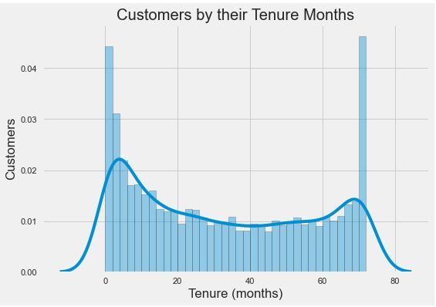
Data Visualization
The histogram I can see that a lot of customers have been with the company for just a month, while quite a many are there for about 70 months. This could be potentially because different customers have different contracts. Thus based on the contract they are into it could be more/less easier for the customers to stay/leave the telecom company

Slide 9
Approach Adapted
After Clear Understanding of data as the Target variable is of categorical data the algorithm approach I opted is of Classification Algorithm.
Random Forests is a Machine Learning algorithm that tackles one of the biggest problems with Decision Trees: variance. Even though Decision Trees is simple and flexible, it is greedy algorithm. It focuses on optimizing for the node split at hand, rather than taking into account how that split impacts the entire tree.

Slide 10
Techniques and Tools
As a project requires data cleaning and visualization I have used few tools for analysis .The following libraries are listed below .
NumPy for Numerical Operation.
Pandas for importing data, imputation of the missing values, summarization and aggregation
Matplotlib and Seaborn for Visualization
scikit-learn is a Python module for machine learning built on top of SciPy

Slide 11
Analysis Section
Feature Engineering :
Feature engineering is the process of extracting features from the data and transforming them into a format that is suitable for the machine learning model. In this project, I need to transform both numerical and categorical variables. Most machine learning algorithms require numerical values; therefore, all categorical attributes available in the dataset should be encoded into numerical labels before training the model. In addition, I need to transform numeric columns into a common scale.
Encoding :

Slide 12
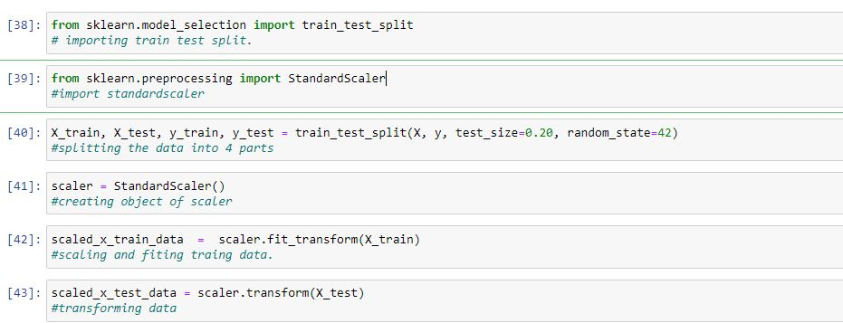
Analysis Section
Standardization and Splitting the data in training and testing sets:
Standardization entails scaling data to fit a standard normal distribution. Splitting the data into two groups, which are typically referred to as training and testing sets.

Slide 13
Analysis Section
Assessing multiple algorithms :
In this project, we compare 4 different algorithms, all of them already implemented in Scikit-Learn.
Logistic Regression with cross validation
Logistic Regression without cross validation
Decision Tree
Random Forest
Among all the Algorithms , the Random Forest has given the best performance so for this data random forest is suitable

Slide 14
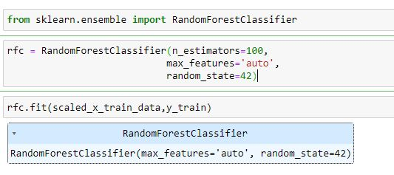
Analysis Section
Random Forest Parameters :
In this I have taken the parameter as n_estimators=100, max_features='auto’, random_state=42 .
n_estimators : The required number of trees in the Random Forest. The default value is 100. We can choose any number but need to take care of the overfitting issue.

Slide 15
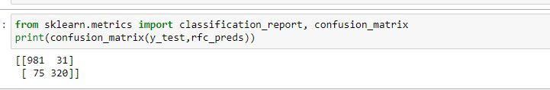
Analysis Section
Performance of the model :
The confusion matrix, also known as the error matrix, is used to evaluate the performance of a machine learning model by examining the number of observations that are correctly and incorrectly classified.
As shown above, 1301 observations of the testing data were correctly classified by the model (981 true negatives and 320 true positives). On the contrary, I can observe 106 misclassifications (31 false positives and 75 false negatives).

Slide 16
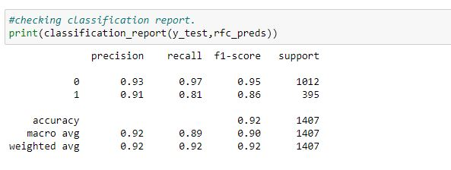
Analysis Section
Evaluation metrics:
Evaluating the quality of the model is a fundamental part of the machine learning process.

Slide 17
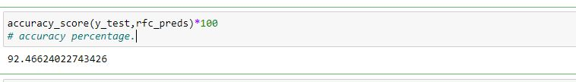
Analysis Section
As shown above, I obtained a sensitivity of 0.81 (320/(320+75)) and a specificity of 0.97 (981/(981+31)). The model obtained predicts more accurately customers that do not churn.
The accuracy score can be calculated easily with help of metrics.
As you can observe, the accuracy of the model is 92%

Slide 18
Conclusion
In this project , I have done a complete end-to-end machine learning project using the Telco customer Churn dataset. I started by cleaning the data and analyzing it with visualization. Then, I able to build a machine learning model, I transformed the categorical data into numeric variables (feature engineering). After transforming the data, I tried 4 different machine learning algorithms using default parameters. Finally, I found the Random Forest Algorithm (best performance model) for model optimization, obtaining an accuracy of nearly 92%.

